Slide 1


Presents to you:- PreCure

Slide 2

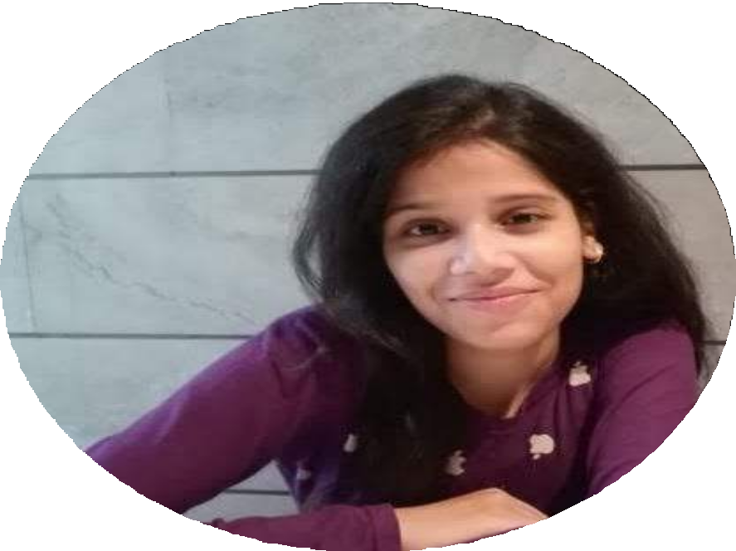
Diksha
Jaya
HMRITM
IT
NSUT
ECE

Slide 3



Problem 1
Lack of awareness among women regarding breast cancer.
Problem Description
Problem 2
Problem in getting reports and appointments online from doctors.
Problem 3
Diificulty in finding doctors for breast cancer in nearby area at right time.

Slide 4

How PreCure solves the mentioned probems.
01
Provides facility to detect type of cancer according to various parameters entered by user, by generating report of the user.
02
03
Know doctors available for appointment nearby and submit your reports.
Comes with an open forum so that people can be aware about breast cancer and discuss about other topics.

Slide 5

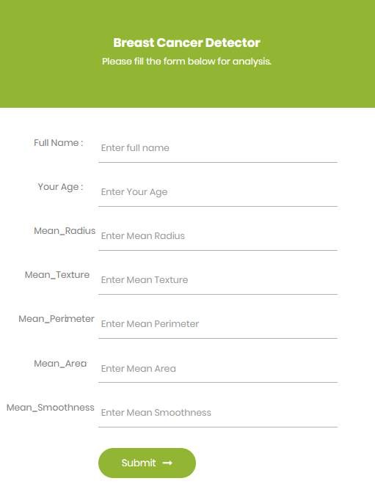
01
Enter your details in given form for analysis.
Based on the updated details, report will be generated giving information about the type of cancer user may have.

Slide 6

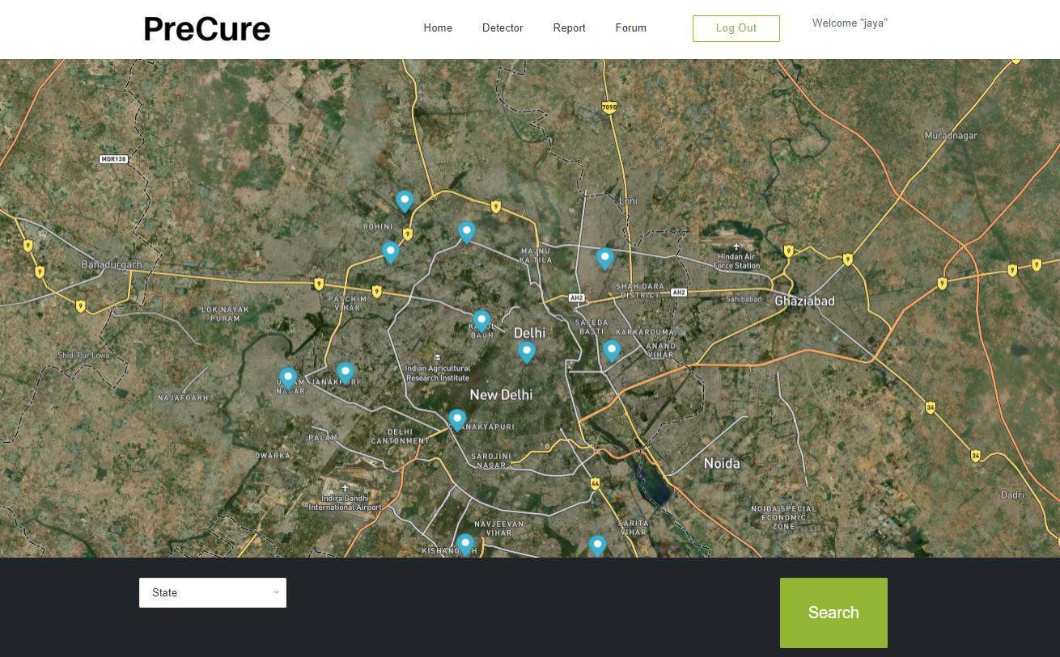
02
Find the doctors near you and submit your report to the doctors around you.

Slide 7

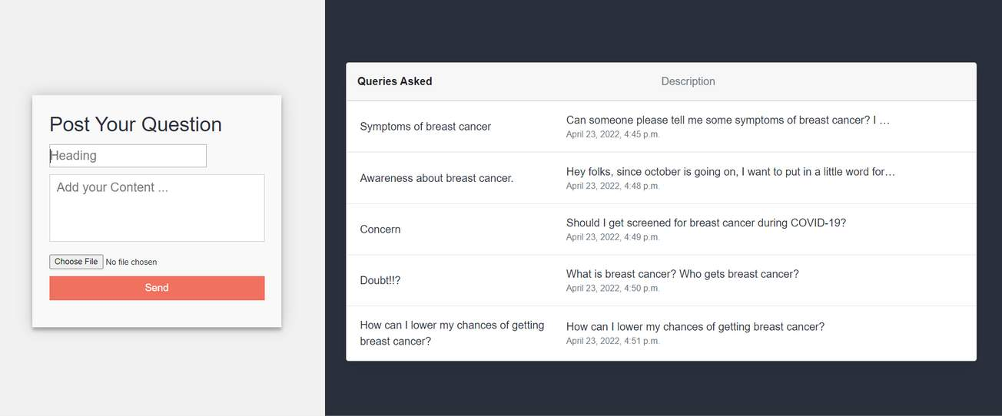
03
Post any queries related to breast cancer in open forum and help spreading awareness about breast cancer to other people also.

Slide 8


Future scope
Emergency contact book
Feature providing various helpline numbers for women's safety in the form of contact book.
Self Defense kit
Where women can learn various tips and techniques for self defense.

Slide 9
Demo Video

Slide 10
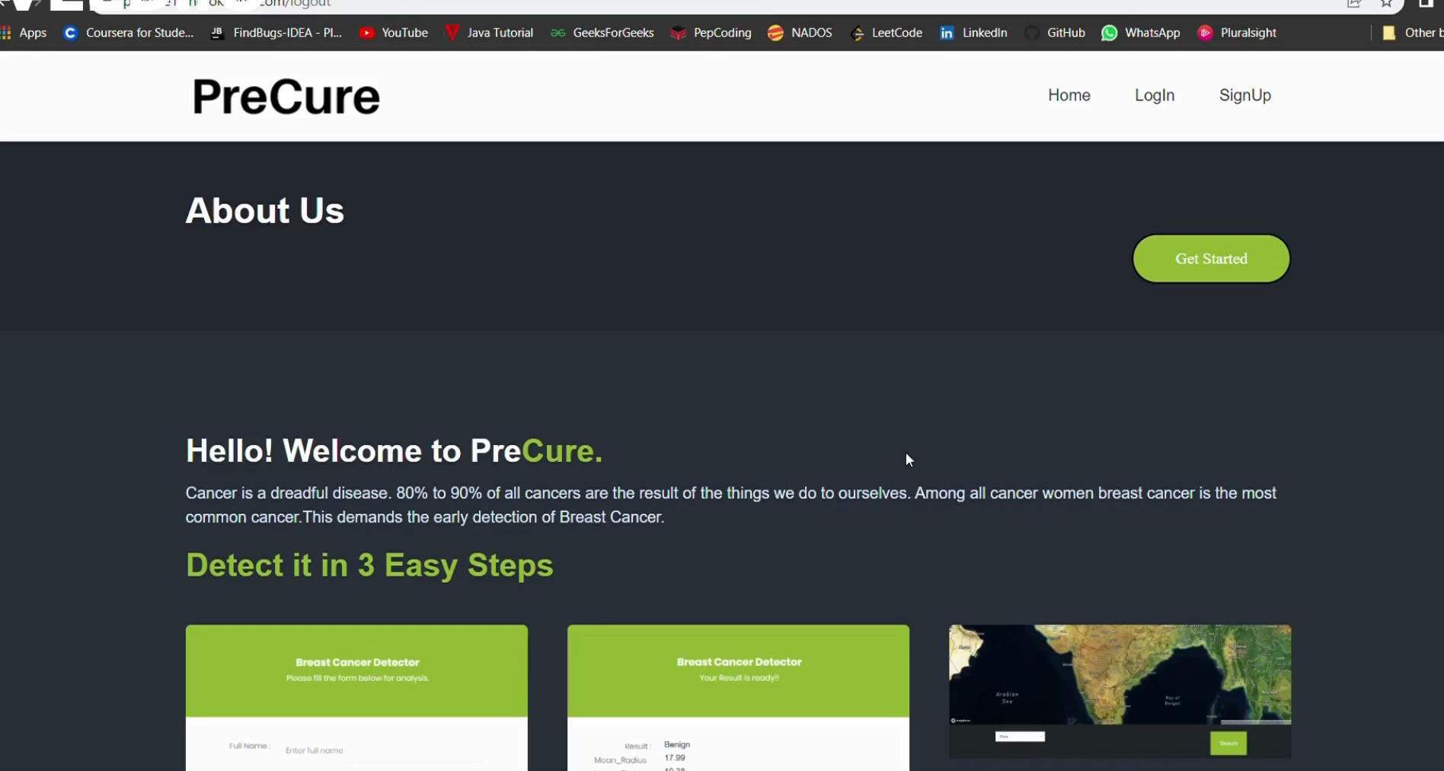

Slide 11







django
WE USED
Required
Website url: PreCure

Slide 12
Thank You!

